Slide 1
5.7 Classical Problems of Synchronization
Classical problems used to test newly-proposed synchronization schemes
Bounded-Buffer Problem
Readers and Writers Problem
Dining-Philosophers Problem

Slide 2
Bounded-Buffer Problem
BUF_SZ elements inside the shared buffer
Semaphore num_full_el initialized to the value 0 – keeps track of the number of elements that are full.
Semaphore num_empty_el initialized to the value n – keeps track of number of elements that are empty.
Why use semaphores, when the previous approach seemed to work fine (i.e. using the in and out indices without using any synchronization primitives)?

Slide 3
Bounded-Buffer Problem
BUF_SZ elements inside the shared buffer
Semaphore num_full_el initialized to the value 0 – keeps track of the number of elements that are full.
Semaphore num_empty_el initialized to the value n – keeps track of number of elements that are empty.
Why use semaphores, when the previous approach seemed to work fine (i.e. using the in and out indices without using any synchronization primitives)?
Because of the busy-waiting problem in which a process or thread may be spending valuable CPU time doing nothing but waiting in a loop!
We may still use the in and out variables to index a particular buffer in the pool.

Slide 4
Bounded Buffer Problem (Cont.)
The structure of the producer process
do {
/* produce an item in next_produced */
...
/* dec empty sem. */
wait(num_empty_el);
/* write/produce to an entry*/
buffer[in] = next_produced;
in = (in + 1) % BUF_SZ;
/* inc full sem. */
signal(num_full_el);
} while (true);
The structure of the consumer process
do {
/* dec full sem. */
wait(num_full_el);
/* read/consume an entry */
next_consumed = buffer[out];
out = (out + 1) % BUF_SZ;
/*inc empty sem.*/
signal(num_empty_el);
... /* consume the item in next consumed */
... } while (true);

Slide 5
Readers-Writers Problem
A data set (e.g. a database) is shared among a number of concurrent processes
Readers – only read the data set; they do not perform any updates
Writers – can read and write
Problem:
Allow multiple readers to read at the same time
Only one writer can access the shared data at the same time (i.e. no other writers or other readers are allowed)
Several variations of how readers and writers are considered – all involve some form of priorities
Shared Data
Data set
Semaphore rw_mutex initialized to 1
Semaphore mutex initialized to 1 (to protect access to read_count)
Integer read_count initialized to 0

Slide 6
Readers-Writers Problem (Cont.)
The structure of a writer process
do { wait(rw_mutex);
... /* writing is performed */
...
signal(rw_mutex);
} while (true);
`

Slide 7
Readers-Writers Problem (Cont.)
The structure of a reader process
do { wait(mutex); read_count++; if (read_count == 1) /* only first reader locks rw_mutex */
wait(rw_mutex);
signal(mutex);
... /* reading dataset is performed, protected by rw_mutex */
/* either one writer, or multiple readers at a time
...
wait(mutex); read count--; if (read_count == 0) /* only last reader unlocks rw_mutex */
signal(rw_mutex);
signal(mutex);
} while (true);
`
`
`

Slide 8
Readers-Writers Problem Variations
First variation – no reader kept waiting unless writer has permission to use shared object
Second variation – once writer is ready, it performs the write ASAP (i.e. no readers are allowed to read till after the writer gets and is done with his access)
Both may have starvation leading to even more variations
In some systems, the kernel provides a reader-writer locks

Slide 9
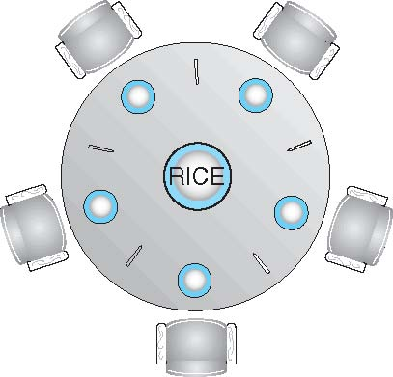
Dining-Philosophers Problem
Philosophers spend their lives alternating between thinking and eating
Don’t interact with their neighbors, occasionally try to pick up 2 chopsticks (one at a time) to eat from bowl
Need both to eat, then release both when done
In the case of 5 philosophers
Shared data analogy:
Each philosopher is a thread
Bowl of rice (data set)
Semaphore chopstick [5] initialized to 1

Slide 10
Dining-Philosophers Problem Algorithm
The structure of Philosopher i:
do {
wait (chopstick[i] );
wait (chopstick[ (i + 1) % 5] );
// eat
signal (chopstick[i] );
signal (chopstick[ (i + 1) % 5] );
// think
} while (TRUE);
What is the problem with this algorithm?

Slide 11
Dining-Philosophers Problem Algorithm (Cont.)
Deadlock handling
Allow at most 4 philosophers to be sitting simultaneously at the table of 5 chopsticks.
Use an asymmetric solution
An odd-numbered philosopher picks up the left chopstick first and then the right chopstick.
An even-numbered philosopher picks up the right chopstick first and then the left chopstick.
Allow a philosopher to pick up the forks only if both are available (picking must be done in a critical section) → we may use monitors to implement this method.

Slide 12
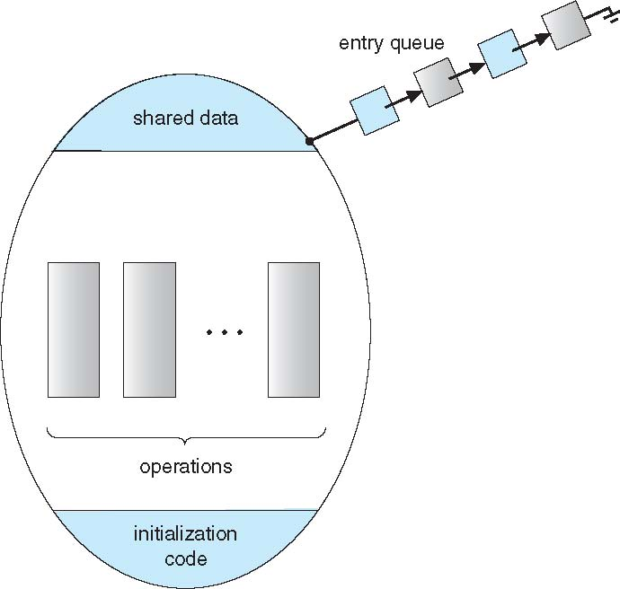
5.8 Monitors
The dining philosophers deadlock may be solved using monitors.
A monitor is a high-level abstraction that provides a convenient and effective mechanism for process synchronization
A monitor is an abstract data type (i.e. an object), internal variables only accessible by code within the procedure
Only one process may be active within the monitor at a time.

Slide 13
5.8 Monitors
monitor monitor-name
{
// shared variable declarations
procedure P1 (…) { …. }
procedure Pn (…) {……}
Initialization code (…) { … }
}
But not powerful enough to model some synchronization schemes
Thus we may use condition variables.

Slide 14
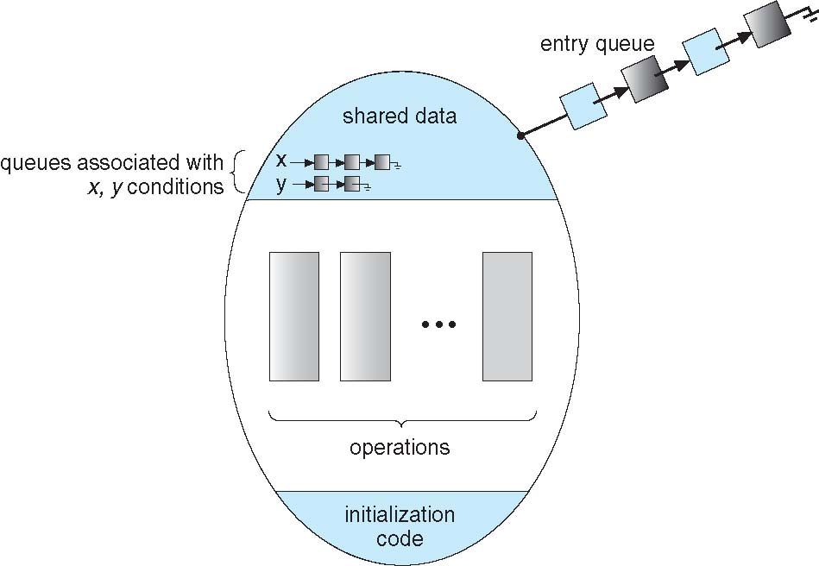
Condition Variables
Condition variables are variables declared inside a monitor:
condition x, y;
Two operations are allowed on a condition variable:
x.wait() – a process that invokes the operation is suspended until x.signal()
x.signal() – resumes one of processes (if any) that invoked x.wait()
Only one thread/process can be active inside the monitor. The process that issues x.wait() becomes inactive, thus allowing others to be active inside the monitor.

Slide 15
Condition Variables – cont.
Contrast this operation with the signal() operation associated with semaphores, which always affects the state of the semaphore:
If there are no threads/processes that are waiting on the condition variable x, then calling x.signal() does not affect the condition variable.
Calling signal(my_semaphore), however, increments the semaphore whether there is someone waiting on it or not.

Slide 16
Condition Variables Choices
If process P invokes x.signal(), and process Q was suspended in x.wait(), what should happen next?
Both Q and P cannot execute in parallel. If Q is resumed, then P must wait
Options include
Signal and wait – P waits until Q either leaves the monitor or Q blocks waiting on another condition (i.e. immediate effect).
Signal and continue – P continues till it leaves the monitor or blocks waiting on another condition, and then Q may become active (i.e. deferred effect).
Both have pros and cons – language implementer can decide

Slide 17
Monitor solution to dining philosophers
monitor DiningPhilosophers
{
enum {THINKING, HUNGRY, EATING} state[5] ;
condition cond[5];
void pickup (int i) {
state[i] = HUNGRY;
test_and_signal(i); /* if successful: my state becomes EATING + signal myself which is wasted cause I am not waiting*/
if (state[i] != EATING) cond[i].wait(); /* test(i) did not succeed */
}
void putdown (int i) {
state[i] = THINKING;
// test left and right neighbors
test_and_signal((i + 4) % 5);
test_and_signal((i + 1) % 5);
}

Slide 18
Monitor solution to Dining Philosophers (Cont.)
void test_and_signal(int i) {
if ((state[(i + 4) % 5] != EATING) &&
(state[i] == HUNGRY) &&
(state[(i + 1) % 5] != EATING) ){
state[i] = EATING;
cond[i].signal();
}
}
initialization_code() {
for (int i = 0; i < 5; i++)
state[i] = THINKING;
}
} /* end of monitor */

Slide 19
Monitor solution to dining philosophers (Cont.)
Each philosopher i invokes the operations pickup() and putdown() in the following sequence:
DiningPhilosophers.pickup(i);
EAT
DiningPhilosophers.putdown(i);
No deadlock, but starvation is possible

Slide 20
Monitor Implementation – Monitors without a condition variable
Variables
semaphore mutex; // (initially = 1)
Each monitor procedure F will be replaced by
wait(mutex);
…
body of F;
…
signal(mutex);
Mutual exclusion within a monitor is ensured

Slide 21
Monitor Implementation – Monitors with a condition variables
For each condition variable x, we have:
semaphore x_sem; // (initially = 0)
int x_count = 0; // num of processes suspended/waiting
// on condition variable
We are implementing the signal-and-wait type condition variables.
A signaling process must wait until the signaled process either leaves or blocks waiting.
Thus we need another semaphore:
// signaling process uses next to suspend itself
semaphore next; // (initially = 0)
int next_count = 0; // num of processes suspended // due to signal-and-wait

Slide 22
Monitor Implementation – Monitors with a condition variables (cont.)
The operation x.wait() can be implemented as:
x_count++;
if (next_count > 0)
signal(next);
else
signal(mutex);
wait(x_sem);
x_count--;
The operation x.signal() can be implemented as:
if (x_count > 0) {
next_count++;
signal(x_sem);
wait(next);
next_count--;
}

Slide 23
Monitor Implementation – Monitors with a condition variables (cont.)
With condition variables, each procedure F will then be replaced by
wait(mutex);
...
body of F
...
// Before exiting, signal other threads that are
// blocked inside the monitor (i.e blocked
// themselves when using the signal-and-wait for
// the condition variable)
if (next count > 0)
signal(next);
else
signal(mutex);

Slide 24
6: Memory Management
Program translation
Program relocation
H/W support for program relocation
Memory partitioning
Memory swapping
Virtual memory
Memory segmentation
Memory paging
Virtual Memory management
Static virtual memory management and demand paging
Dynamic virtual memory management

Slide 25
Program translation
file1.c
file2.c
file3.asm
coding
Source files (text files)
compiling
file1.o
file2.o
file3.o
lib1.lib
Object files: relocatable object modules (binary files)
linking
app.out
absolute module
(binary file)
Loading
(e.g. by OS)
Notes:
Embedded software applications are usually coded in c or c++ (Java applications running on Android are usually not considered embedded applications).
The compiler converts the source code for each file into a relocatable object code.
The linker relocates and combines all the object files into a single output file, and puts it in a format that is readable by the loader or device programmer.

Slide 26
Program translation – linking + loading
Memory
File1.o
app.out
Low address
OS
.txt
.txt
.const
File2.o
Other process
.txt
.const
.data
txt
.const
.data
.bss
File3.o
.data
.txt
data
.bss
.bss
.const
heap
High address
.data
stack
.bss
Other process
Notes:
Unlike a conventional programmer, an embedded software engineer needs to be well aware of how the compiled binary code is formed and loaded into the memory at run time. He is the one who has to setup this up.
Each object file has a txt section holding the CPU instructions, a .const section holding the constant variables, a .data section for the pre-initialized variables, and a .bss section for uninitialized variables (bss = block starting with a symbol)
The linker combines the various object file by relocating their addresses.
Additionally, the linker, which is controlled by a setup file, stores the initialization values of the data section into a .cinit section.
The non-volatile parts of the program are programmed into the flash.
At run time, the pre-initialized portion (the .data section) is loaded from the cinit section within the flash via the run-time support library.

Slide 27
Example:
0000 . . .
. . .
0008 [space for gVar]
. . .
0036 Entry proc_a
. . .
0220 mov R1,#7
0224 st R1, [0008]
0228 push R1
0232 call “put_record”
. . .
0400 External reference table
. . .
0404 “put_record” 0232
. . .
0500 External definition table
. . .
0540 “proc_a” 0036
0600 Symbol table (optional)
. . .
0799 Last location in the module
static int gVar;
int proc_a(int arg){
. . .
gVar = 7;
put_record(gvar)
}
Source file
Relocatable object file

Slide 28
0000 . . .
. . .
0008 [space for gVar]
. . .
0036 Entry proc_a
. . .
0220 mov R1,#7
0224 st R1, [0008]
0228 push R1
0232 call “put_record”
. . .
0400 External reference table
. . .
0404 “put_record” 0232
. . .
0500 External definition table
. . .
0540 “proc_a” 0036
0600 Symbol table (optional)
. . .
0799 Last location in the module
0000 Other module
. . .
1008 [space for gVar]
. . .
1036 Entry proc_a
. . .
1220 mov R1,#7
1224 St R1, [1008]
1228 Push R1
1232 call 2334
. . .
End of proc_a
. . . Start of Other module
Entry put_record
. . .
(optional symbol table)
2999 (last location in module)
Absolute module
NOTE: Relocatable object files and absolute modules are binary files (not text) – Above is only a representation of the actual binary files
Relocatable object file

Slide 29
Program translation - Relocation issues
Referencing static variables:
gVar was located at location 0008, but now it is located at 1008. What happens to instructions trying to access gVar ?
Clearly, the linker now needs to get to every instruction that accesses gVar and change its reference to location 1008. There are multiple ways of doing this:
Linker finds every load or store instruction trying to access the old memory location and changes the address to the new location.
Linker uses the optional symbol table, where each relocatable symbol is readily listed and it can easily pin point which instruction is accessing gVar
Absolute branches
Relative branches are not a problem since they specify an offset from the current program counter location.
Linker needs to modify addresses referenced in absolute branches (or calls) just as it did for static variable, e.g. the call to “put_record” gets replaced with the absolute (aka logical) address of “put_record”.

Slide 30
Program translation – file formats
Source files:
Formatted as text files
e.g. main.c
Relocatable object modules and absolute modules:
Contain binary machine instructions + information used by linker or loader
Formatted as binary files.
Common formats are:
COFF: common object file format – commonly used in embedded systems (e.g. microcontrollers: program is loaded into flash memory)
PE: portable executable format – used in Windows, extension is .exe
ELF: Executable and linkable format – used in Unix/Linux systems.

Slide 31
Program translation – loading
Memory may be partitioned to accommodate multiple running processes.
A program is loaded into an area of memory that does not necessarily start at address 0x00.
Thus more relocation needs to take place at load time.
Low address
Memory
OS
Other process
txt
data
heap
stack
Other process
High address

Slide 32
Other process and OS
0000 Other module
. . .
1008 [space for gVar]
. . .
1036 Entry proc_a
. . .
1220 mov R1,#7
1224 st R1, [1008]
1228 push R1
1232 call 2334
. . .
1399 End of proc_a
. . . Start of Other module
2334 Entry put_record
. . .
2670 (optional symbol table)
2999 (last location in module)
Other modules
. . .
5008 [space for gVar]
. . .
5036 Entry proc_a
. . .
5220 mov R1,#7
5224 st R1, [5008]
5228 push R1
5232 call 6334
. . .
5399 End of proc_a
. . . Start of Other module
6334 Entry put_record
. . .
6999 (last location in module)
Other process
Absolute module
e.g. PE (.exe), ELF, COFF, etc.
MEMORY

Slide 33
Program translation – cont.
The process of finding an address in the physical memory (physical address) and attaching it to the relocatable address in the absolute module (= logical address as in your text book) is referred to as binding. This binding takes place at load time.
Similarly another binding takes place when attaching addresses in the relocatable object module into addresses in the absolute module. This binding takes place at compile time.
Note that in many systems, it may be that the entire system only runs one program and the logical address may be the same as the physical address (e.g. a microcontroller), and thus there may be no need for load-time address binding.
User programs are designed using the logical address, i.e. the program thinks it is running alone in memory and thinks it starts at address 0.

Slide 34
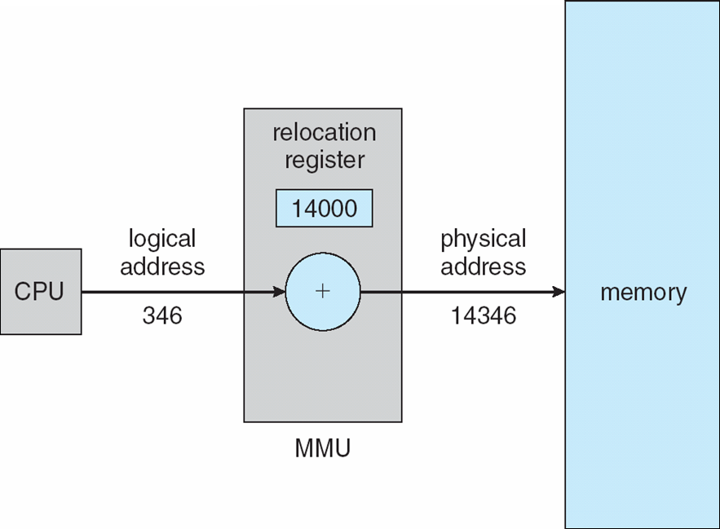
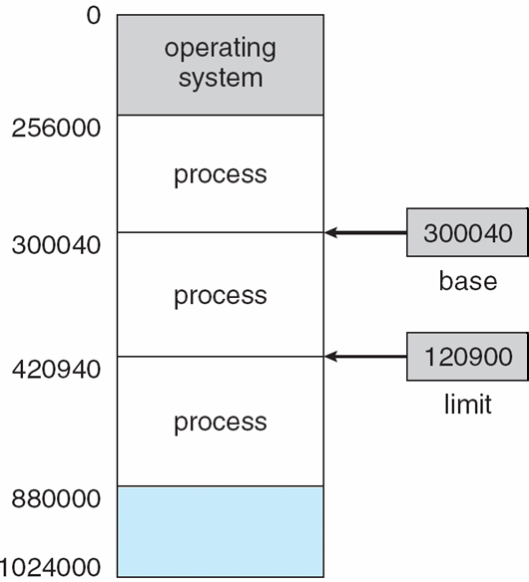
Hardware relocation support
A relocation register may be used to convert the logical address to a physical address. This register may be also referred to as a base register.
Since a program’s logical address starts at 0x0000 but needs to be loaded and executed at a different location in the physical memory, a base register may be summed to every logical address before that address is dispatched to the main memory -> thus it does the job of binding instead of the loader.
Many of the older intel CPUs (e.g. 8088) supported 4 segment registers for: code, data, stack and extra segments.
300040
300386
Relocation register

Slide 35
Hardware Memory protection
CPU may check every physical memory access generated by a process to be sure it is between base and limit registers. This hardware thus performs memory protection.
If a process attempts to access an address that is outside its limits, an exception takes place and the OS kernel is invoked.
OS is responsible for setting the correct values in base and limit registers for each process prior to loading it. OS is also in charge of saving that information in the PCB during context switching.
An exception takes place

